Slide 1
Comparison of Annual Members & Casual Riders Bike Usage
Presented By: Marcia Searwar
Last Updated On: 21-Sep-2021

Slide 2
Agenda
Objective
Findings
Recommendations
Questions

Slide 3
Objective
To analyse how annual members and casual riders use Cyclistic bikes differently in order to determine the best marketing strategy to convert casual riders into annual members.
Notes:
The problem is how to convert casual riders into annual members.

Slide 4
Findings
Number of Trips
Overall
By Month
By Day of Week
By Hour of the Day
Trip Lengths
24 hours and less
Greater than 24 hours
Most Popular Trips
Bike Type
Overall

Slide 5
Data Used
Source: Monthly data directly from the company’s website
Period covered: August 2020 to August 2021
Data anomalies were cleaned as far as possible
Notes:
Records that were excluded:
Start time greater than end time
Trip lengths (in minutes) less than or equal to 0
Start or End station names were null
Start or End station names like ‘Base Warehouse’
The station IDs were inconsistent. Not only was the data type changed from string to number but the IDs did not consistently match the station names. For these reasons, the station IDs were not used.
The ride IDs were not unique. Will need further clarification on this.
Will also need further clarification if trips can legitimately be less than or equal to one minute.

Slide 6
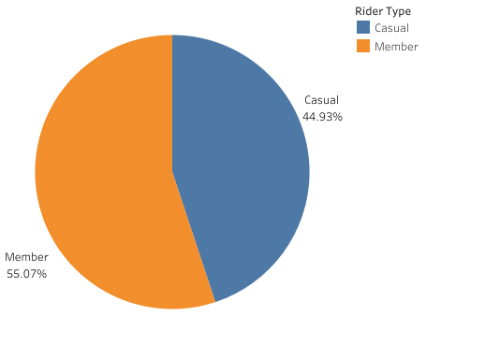
Number of trips: Overall
Key takeaway
Annual Members make the most trips overall
Notes:
Number of trips shown as a percentage

Slide 7
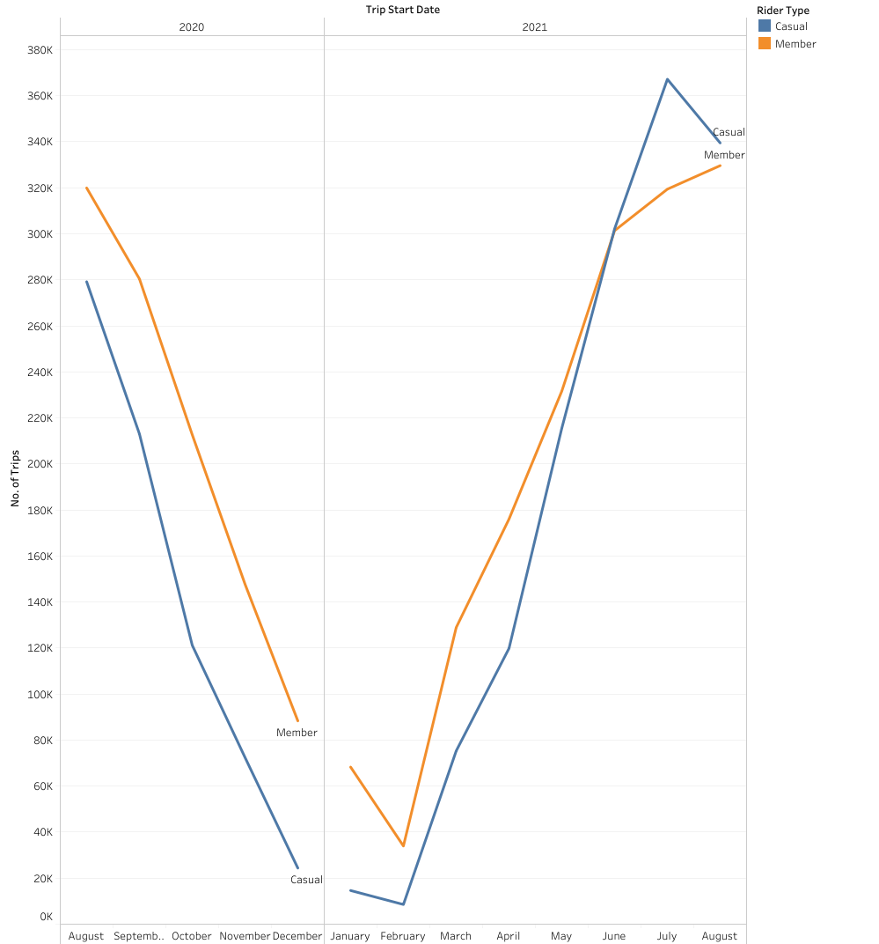
Number of trips: Month
Key takeaways
Casual Riders overtook the Annual Members from May 2021
Further analysis is needed to identify:
If this pattern is consistent with other years
How much COVID-19 has affected the number of trips taken per month
Notes:
Used the trips’ Start Date to get the Month

Slide 8
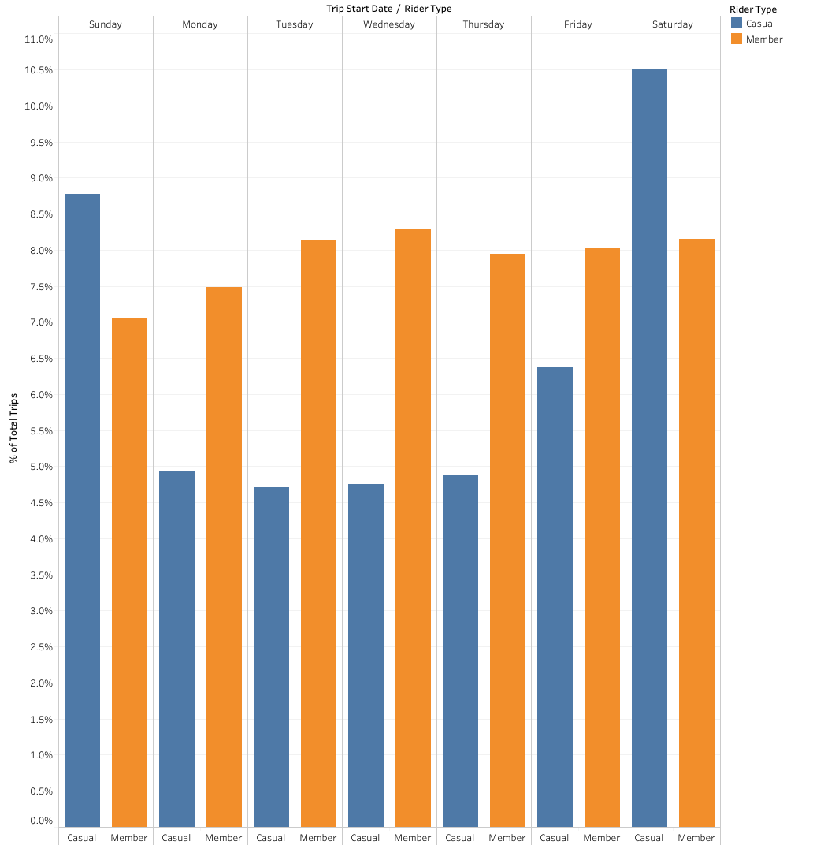
Number of trips: Week Day
Key takeaways
Casual Riders made most trips on Sundays and Saturdays
Trips made by Annual Members are consistent for most of the week days.
Notes:
Used the trips’ Start Date to get the Week Day
No. of Trips as a percentage

Slide 9
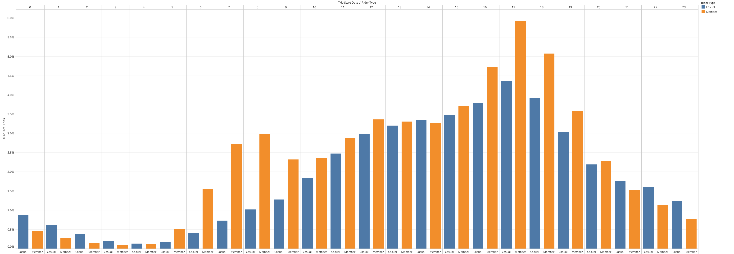
Number of trips: Hour of Day
Notes:
Used the trips’ Start Date to get the Hour of Day
No. of Trips as a percentage

Slide 10
Number of trips: Hour of Day (cont’d)
Key takeaways
Peak times for Annual Members indicate trips to and from work:
15 hrs to 19 hrs
12 hrs to 13 hrs
7 hrs to 8 hrs
Trips made by Casual Riders increases throughout the day, peaking at 17 hrs

Slide 11

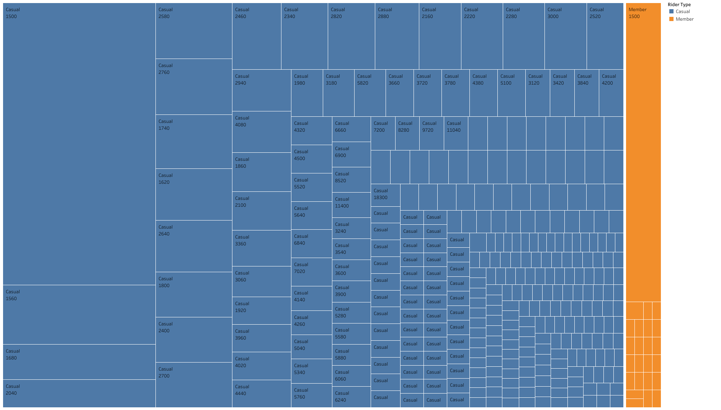
Trip Lengths
24 Hours And Less
Greater Than 24 Hours
Key Takeaways
Length of Annual Members’ trips is mainly less than 1 hour (between 0 to 59 minutes)
Casual Members typically make trips greater than 24 hours long

Slide 12
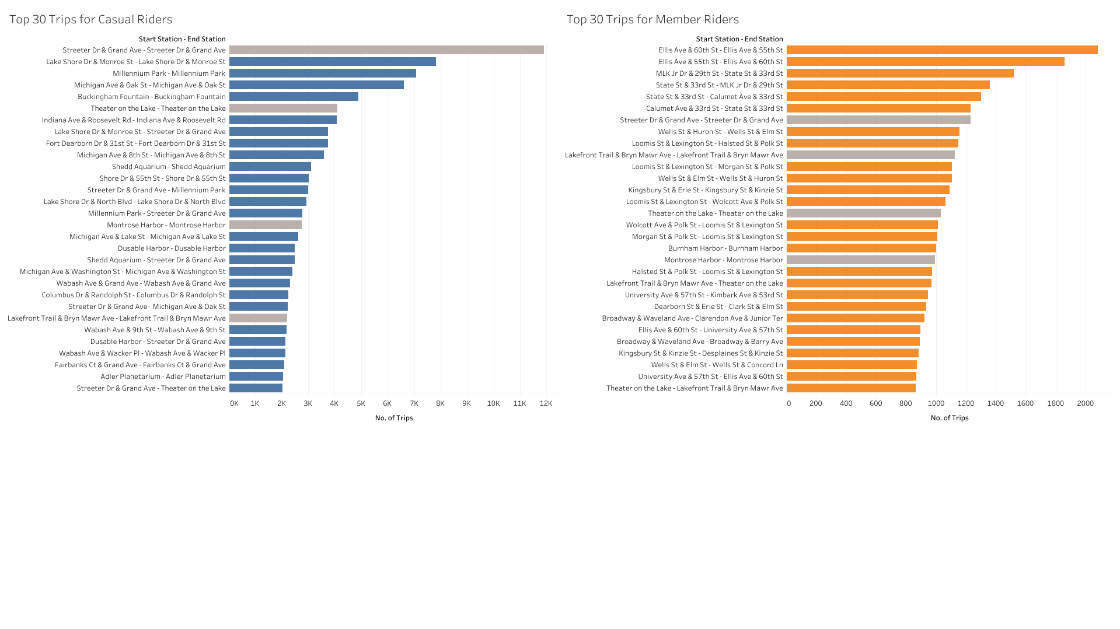
30 most popular Trips
Key Takeaways
Only 4 trips are the same for both Casual Riders and Annual Members
Most Casual Members do the Streeter Dr & Grand Ave return trip
Annual Members make more trips but start and end stations vary widely; More Casual Riders make the same trips.
Notes:
Shows the start and end stations for top 30 trips
Note the different X axis
Same trip for both Casual Rider and Annual Member highlighted in gray

Slide 13
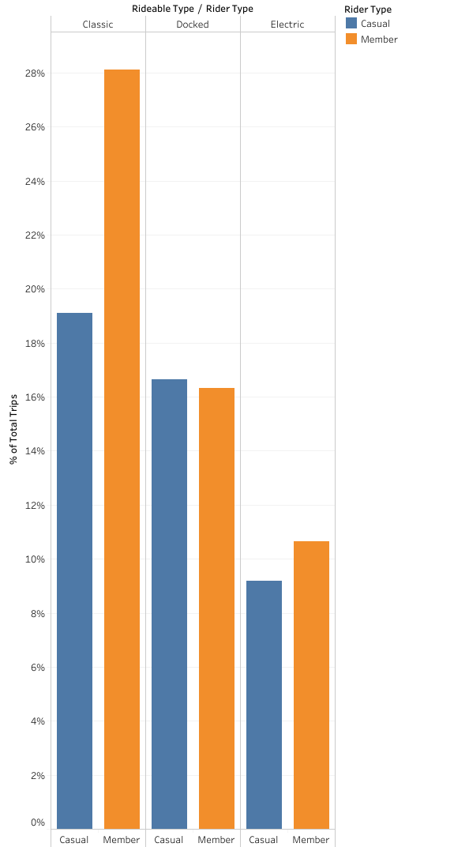
Bike Type: Overall
Key Takeaways
Both Annual Members and Casual Riders prefer the Classic bike
Electric bikes were least preferred
Analysis was done for Week Day and Hour of the Day. However, it yielded no new insights - more data about a rider will be needed for substantive analysis.
Notes:
No. of Trips as a percentage

Slide 14
Overall Takeaways
Casual Riders mainly use the Streeter Dr & Grand Ave, Lake Shore Dr & Monroe St, Millenium Park stations
Efforts can be targeted in these areas
While most Casual Riders make trips that last longer than 24 hours, there is a significant number of them that do trips for 24 hours and less
These can be prioritised in a campaign
The data suggests that Casual Riders use bikes mainly on the weekend while Annual Members tend to use it for getting to and from work
First priority should be aimed at those Casual Riders who use bikes like Annual Members
Both Annual Members and Casual Riders prefer the Classic and Docked bikes over the Electric bikes.

Slide 15
Next Steps
Clarify anomalies in the existing data
Trip lengths (in minutes) less than or equal to 0
Start or End station names were null
Inconsistent station IDs
Non-unique ride IDs
Gather more data for further analysis
Multiple years of data for comparison
How has COVID-19 pandemic affected the trends seen in this data
Riders’ data (eg. personal details, address) will facilitate more targeted marketing strategies
What is the typical age of a rider? How does this influence bike usage?
When/how do non-typical age riders use the bikes?
Rider usage data – asking the riders pertinent questions (eg, via survey)
Why do they use the bikes? For work, leisure?

Slide 16
Thank You!
Questions?

